Slide 1
Stock Price Prediction
Saeed Rafieepour

Slide 2

The problem
The prediction of stock market trends stands as a pivotal area of investigation in the domain of machine learning.
The stock market is known for being volatile, dynamic, and nonlinear. Accurate stock price prediction is extremely challenging because of factors, such as politics, global economic conditions, unexpected events, a company’s financial performance, and so on.
Fundamental Analysis vs Technical Analysis
Fundamental analysis: Evaluates a company’s stock by examining its intrinsic value, including but not limited to tangible assets, financial statements, management effectiveness, strategic initiatives, and consumer behaviors; essentially all the basics of a company. Generally speaking, it is more of along-term trend predictions and is not affected by the news. This method requires deep knowledge of finance.
Technical analysis: Uses the historical data to forecast the short term changes in the stock prices. It is very much affected by the news.

Slide 3
Objectives and scope of the work
The primary goal of this project is to predict stock prices given the historical price data. The modeling methodologies include both ARIMA (Autoregressive Integrated Moving Average) and LSTM (Long Short-Term Memory, an example of recurring neural networks - RNN). The approach consists of following steps: data wrangling, exploratory data analysis, model training, model selection and applying.
Which of the LSTM and ARIMA models better predict the stock prices?

Slide 4
ARIMA
Stands for Autoregressive Integrated Moving Average
AR (Autoregressive model):
The autoregressive model specifies that the output variable depends linearly on its own previous values
AR(p) Y_{t} = β₀ + β₁Y_{t-1} + β₂Y_{t-2} + ... + β_{p}Y_{t-p} + e_{t}
MA (Moving Average):
Moving average model is a common approach for modeling univariate time series. It specifies that the output variable depends linearly on the current and various past values.
MA (q) Y_{t} = µ + e_{t} + θ₁e_{t-1} + θ₂e_{t-2} + ... + θ_{q} e_{t-q}
ARIMA models are generally denoted ARIMA(p,d,q) where parameters p, d, and q are non-negative integers, p is the order (number of time lags) of the autoregressive model, d is the degree of differencing (the number of times the data have had past values subtracted), and q is the order of the moving average model.

Slide 5
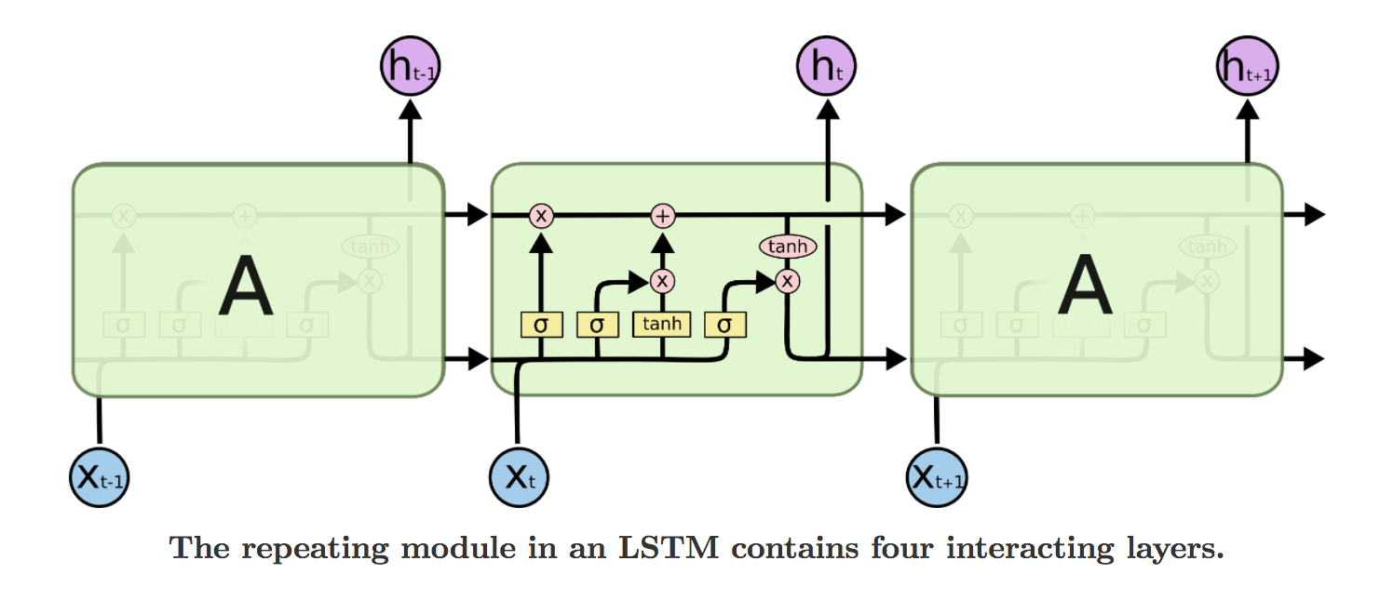
LSTM
Long Short Term Memory is a RNN architecture which addresses the problem of training over long sequences and retaining memory.
A simple recurrent network suffers from a fundamental problem of not being able to capture long-term dependencies in a sequence.

Slide 6
Feature Engineering
For the Long Short-Term Memory (LSTM) model, several features were created from the original closing prices. A look back variable was defined to create features by shifting the data for one time-period, two time periods, and so on. These features then were uses as the X variable and the original price variable was used as the dependent variable. A function was developed to create the dataset from the input dataframe that is suitable for the LSTM model. It receives these inputs: dataframe, the number of time-periods to look back, the splitting size, and any sort of transformation.
For the ARIMA model, the stock price values are given as a Pandas Series and no feature engineering was conducted on the datasets.

Slide 7
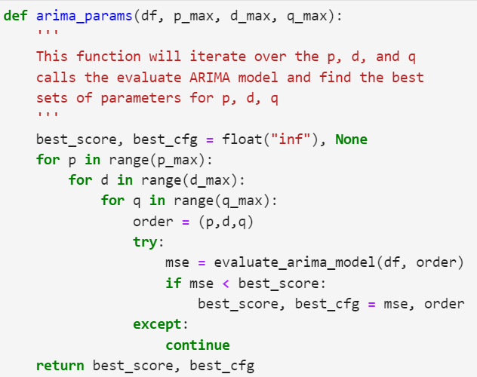
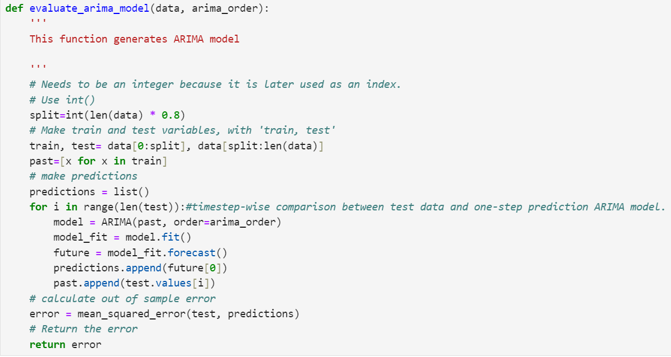
Optimum p, d, and q for ARIMA model

Slide 8
Data Source
The datasets used for this project are from Kaggle! All datasets are in CSV format.
Dataset – 1: From Yahoo Financials and it includes Apple, Microsoft, Google, and Amazon stock prices.
Is between 2012, 01, 01 to current time in 2024.
Dataset has 6 features, but only one feature (close prices) is used in the time series analysis.
Only Apple stock data are used.
Dataset – 2: The Standard & Poor's 500, abbreviated as the S&P 500, is an American stock market index based on the market capitalizations of 500 large companies having common stock listed on the NYSE or NASDAQ.
Is between 1950 to 2017.
Dataset has 6 features, but only one feature (close prices) is used in the time series analysis.
Only “sphist” stock data is used for prediction purposes.
Dataset – 3: CAC40 Stocks that represents a capitalization-weighted measure of the 40 most significant stocks among the 100 largest market caps on the Euronext Paris. Its acronym stands for Cotation Assistée en Continu.
Is between 2010 to 2020.
Dataset has 6 features, but only one feature (close prices) is used in the time series analysis.
Only “TOTAL” company’s stock prices are used.

Slide 9
Data Wrangling
Data wrangling and cleaning is simply by removing any duplicates, renaming the columns, and performing some resampling as some of the data are for frequency in days, which makes the conversion for ARIMA method a bit daunting.

Slide 10
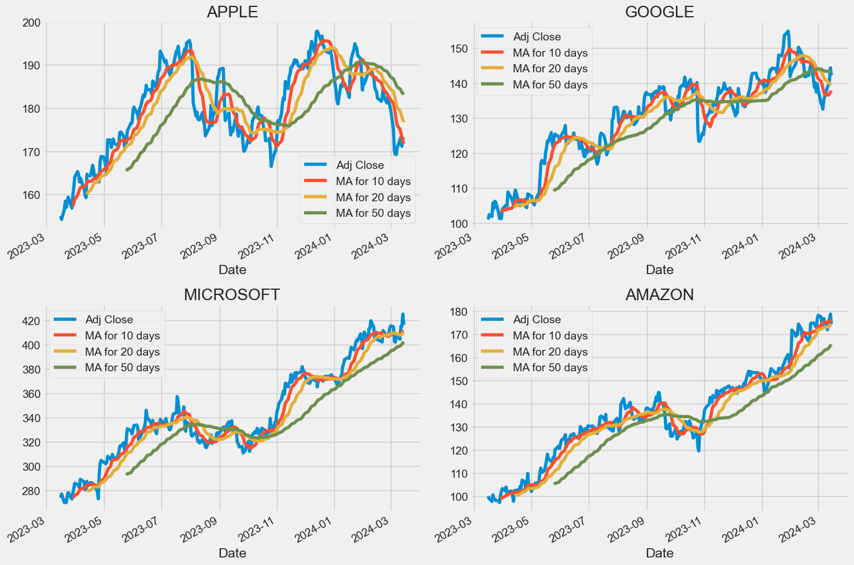
Exploring Dataset-1: Stock trends for 10, 20, and 50 days moving averages

Slide 11
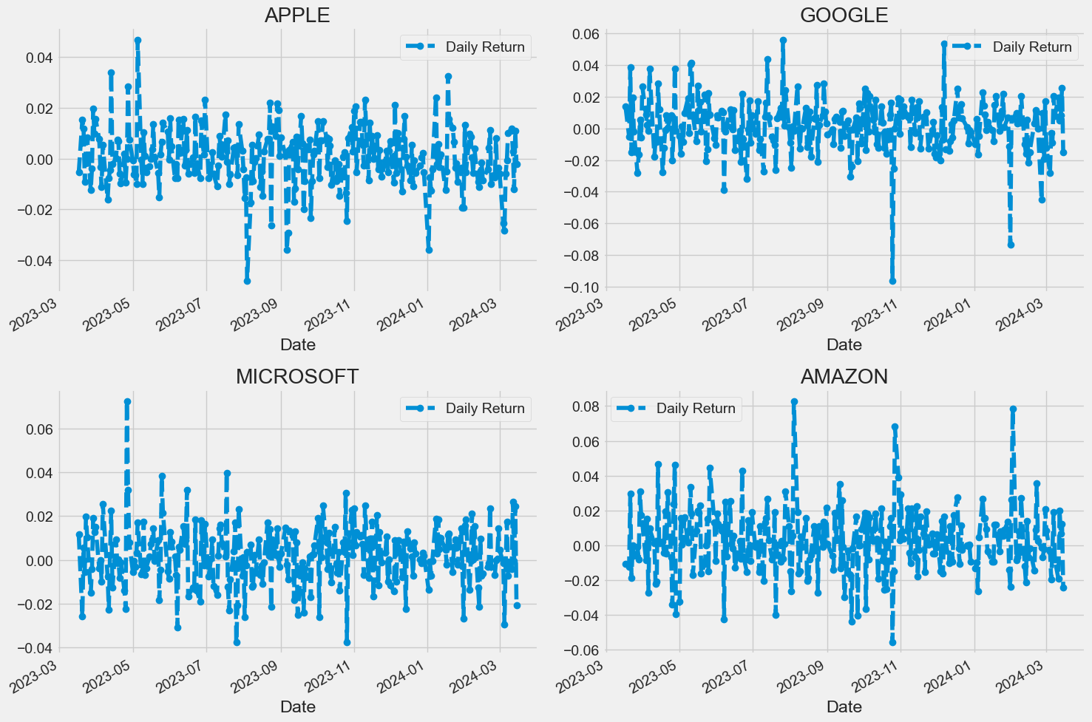
Exploring Dataset-1: Daily return

Slide 12
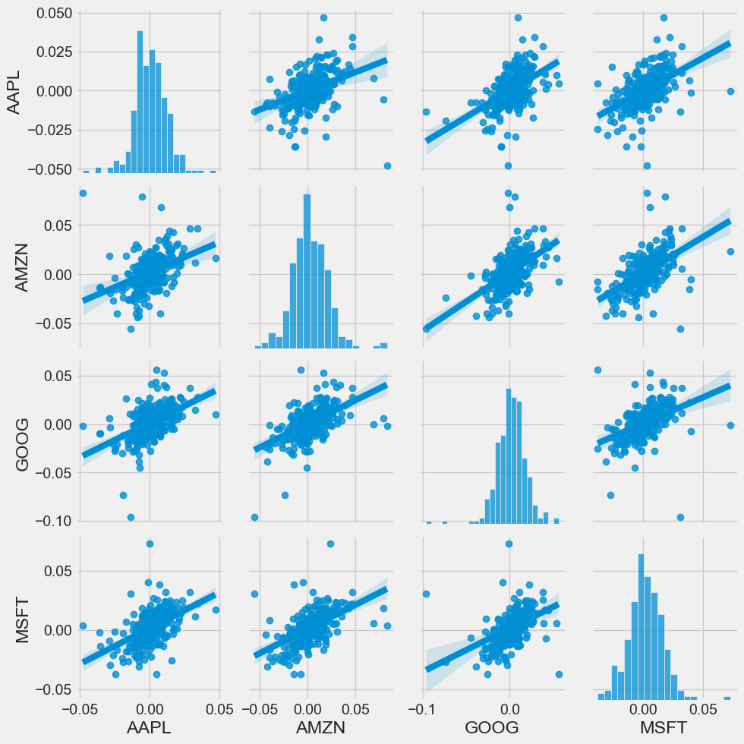
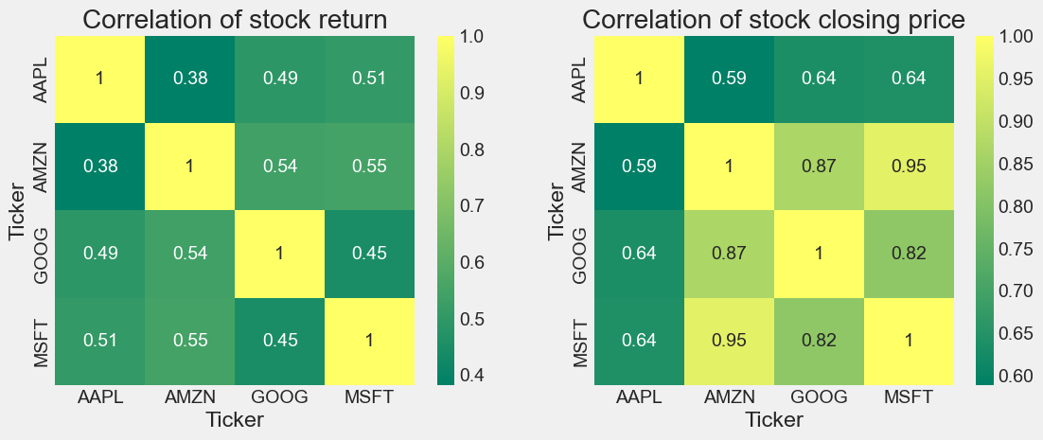
Exploring Dataset-1: Stock prices correlation

Slide 13
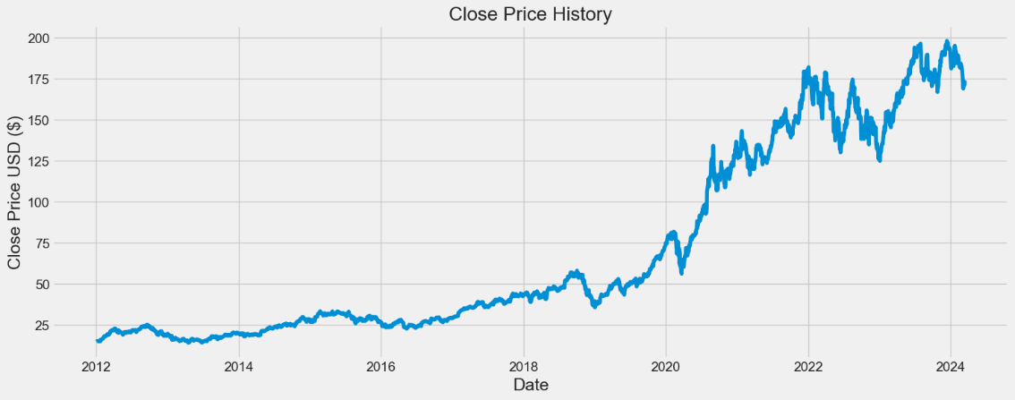
Dataset-1: Apple stock data

Slide 14
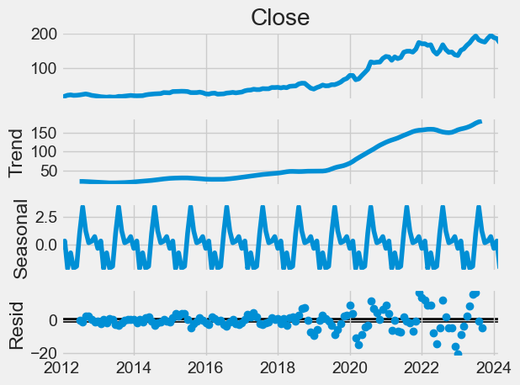
Dataset-1: Apple stock data Decompose
p | d | q
1 | 0 | 2

Slide 15
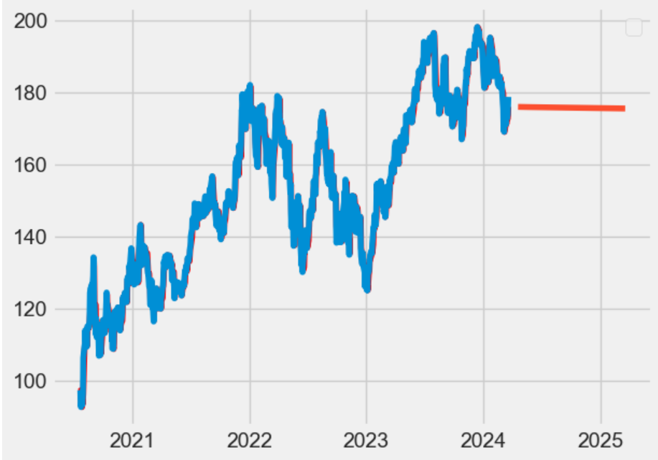
Dataset-1: Apple stock data ARIMA’s results

Slide 16
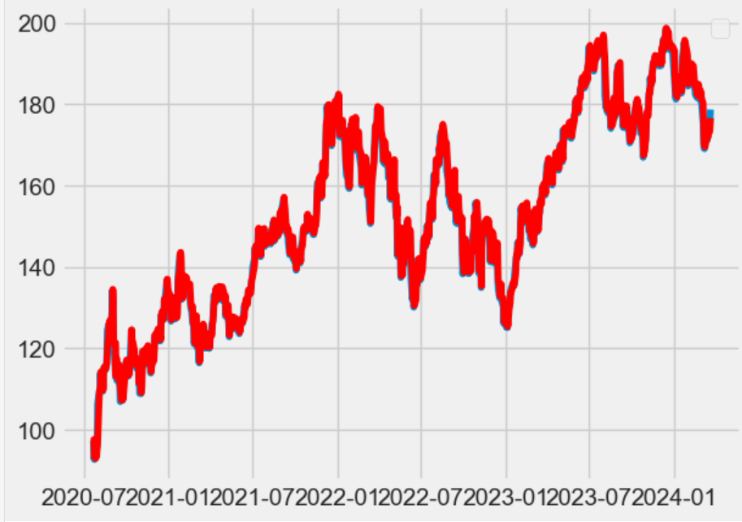
Dataset-1: Apple stock data LSTM’s results

Slide 17
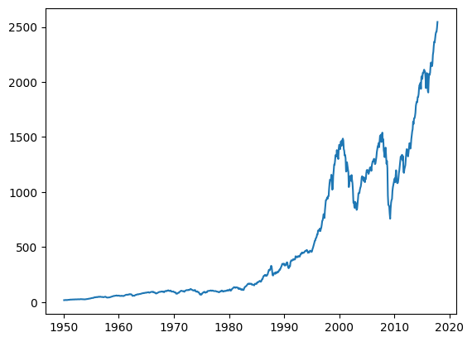
Dataset – 2: S&P 500 Stock Data

Slide 18
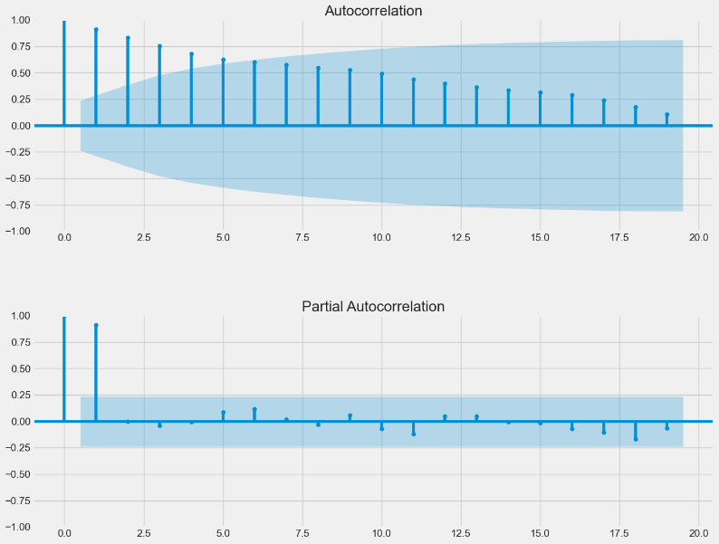
Dataset-2: S&P 500 data-ACF and PACF Plots
p | d | q
0 | 2 | 2

Slide 19
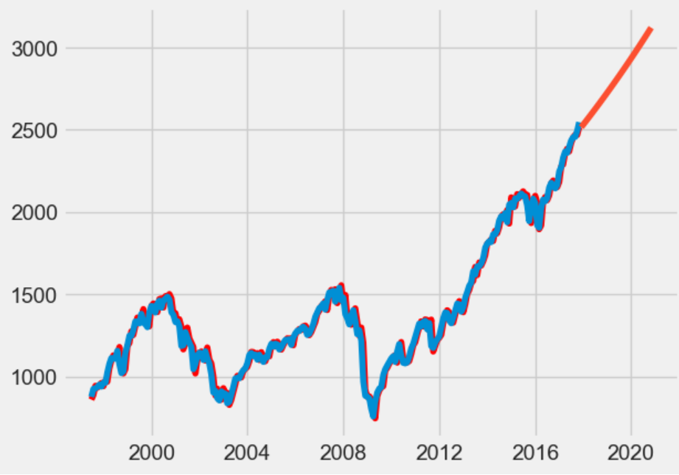
Dataset-2: S&P 500 data-ARIMA’s results

Slide 20
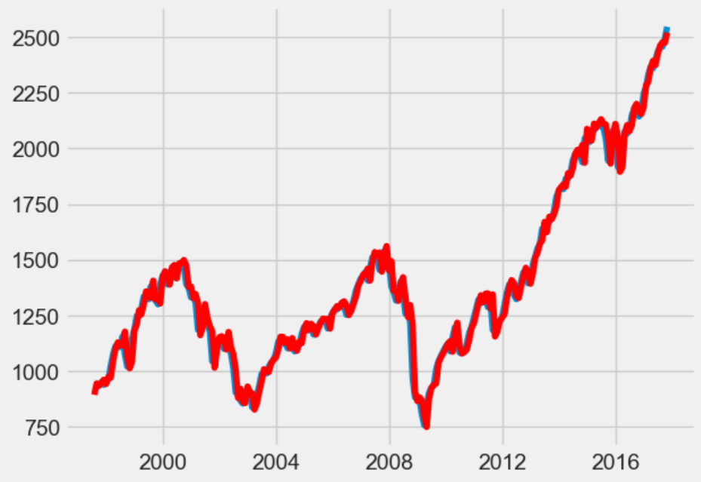
Dataset-2: S&P 500 data-LSTM’s results

Slide 21
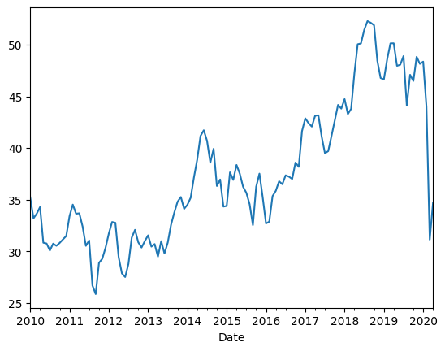
Dataset-3: CAC40 Stock Data

Slide 22
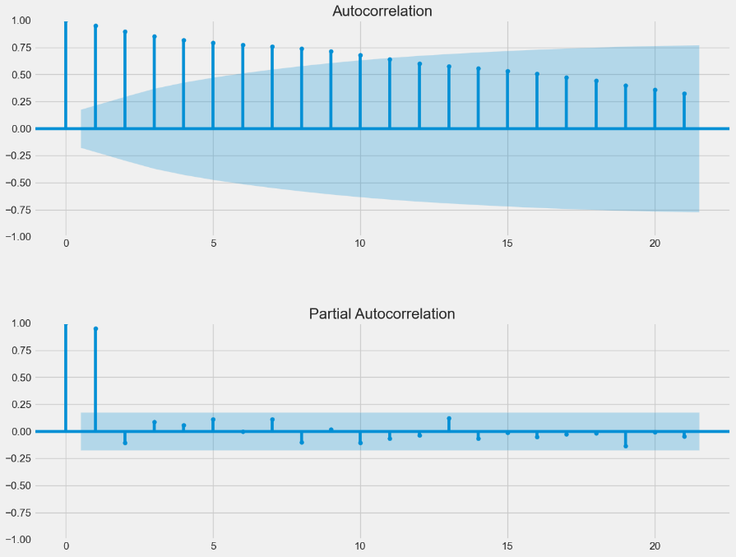
Dataset-3: CAC40 data-ACF and PACF Plots
p | d | q
1 | 0 | 0

Slide 23
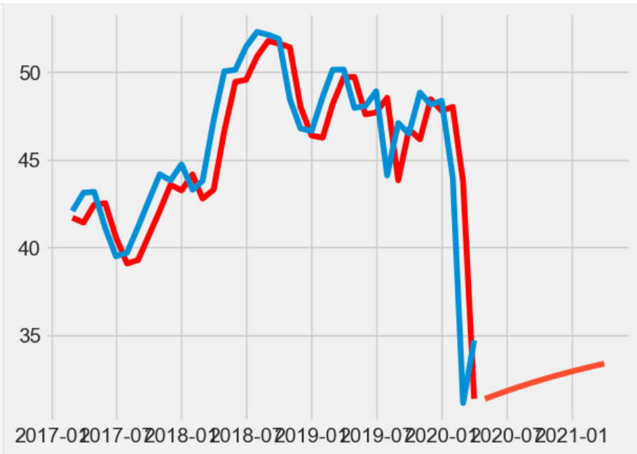
Dataset-3: CAC40 data-ARIMA’s results

Slide 24
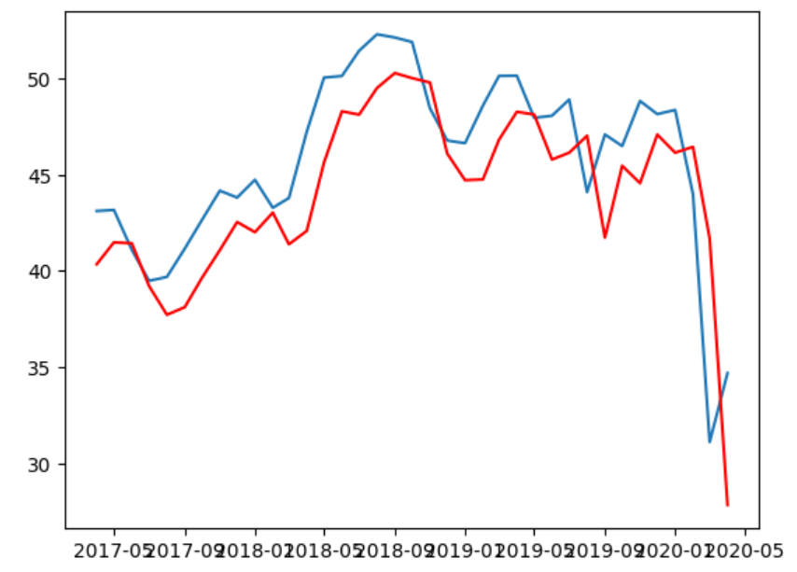
Dataset-3: CAC40 data-LSTM’s results

Slide 25
Summary
The ARIMA and LSTM models were implemented on three stock datasets.
The datasets were tested for stationarity and were decomposed to separate the trend, seasonality and residual values.
The optimum values for p, d, and q were obtained by iterating through values of these parameters, evaluating the model for each set of parameters and then find the best sets of values by minimizing the minimum squared error (MSE).
The ARIMA model gave slightly lower root mean squared errors (RMSEs) in all of the studied time series compared to the LSTM model. Overall, the models gave similar errors, but on the whole, ARIMA provided higher-quality results, though it struggled to converge on a some of the series (especially the first dataset).
 | Dataset 1 |  | Dataset 2 |  | Dataset 3
 | ARIMA | LSTM | ARIMA | LSTM | ARIMA | LSTM
Train RMSE | - | 0.763 | - | 6.850 | - | 2.138
Test RMSE | 2.692 | 2.710 | 45.527 | 45.897 | 2.835 | 3.316

